Slide 1

Daniel Segan
dsegan@me.com |  @dsegan |  danielsegan

Slide 2
About me
Director of App Innovation @ CloudScale
MS Partner based in NYC & LA/SoCal
20+ years in the MS Partner Space
Started way back in the day… before .Net
ASP.Old, VB6, C++/MFC/COM, C
Got started on Unix, SunOS/Solaris
A lot of work with SharePoint
Have been a bit of a skeptic/curmudgeon about EF, and am not an expert

Slide 3
Overview
Brief history of Entity Framework
EF Core vs EF 6
New Tooling
The Basics
Migrations
Complex Relationships

Slide 4
Questions
Who’s using .Net Core?
Who’s using EF6/Core?
Who’s using other ORMs?
What do you think of EF6/Core?
What DB platforms are you using?
Visual Studio 2017 or VSCode?

Slide 5
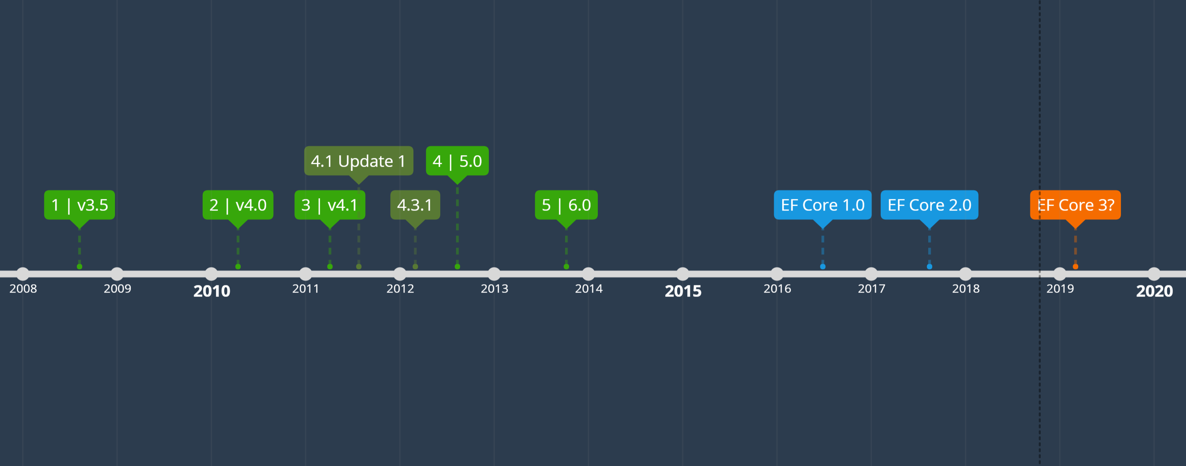
History: Entity Framework v1 – v6
Notes:
From Wikipedia:
1) The first version of Entity Framework (EFv1) was included with .NET Framework 3.5 Service Pack 1 and Visual Studio 2008 Service Pack 1, released on 11 August 2008. This version was widely criticized, even attracting a 'vote of no confidence' signed by approximately one thousand developers.^{[3]}
The second version of Entity Framework, named Entity Framework 4.0 (EFv4), was released as part of .NET 4.0 on 12 April 2010 and addressed many of the criticisms made of version 1.^{[4]}
2) A third version of Entity Framework, version 4.1, was released on April 12, 2011, with Code First support.
3) A refresh of version 4.1, named Entity Framework 4.1 Update 1, was released on July 25, 2011. It includes bug fixes and new supported types.
The version 4.3.1 was released on February 29, 2012.^{[5]} There were a few updates, like support for migration.
4) Version 5.0.0 was released on August 11, 2012^{[6]} and is targeted at .NET framework 4.5. Also, this version is available for .Net framework 4, but without any runtime advantages over version 4.
5) Version 6.0 was released on October 17, 2013^{[7]} and is now an open source project licensed under Apache License v2. Like ASP.NET MVC, its source code is hosted at GitHub using Git.^{[8]} This version has a number of improvements for code-first support.^{[9]}
Microsoft then decided to modernize, componentize and bring .NET cross-platform to Linux, OSX and elsewhere, meaning the next version of Entity Framework would be a complete rewrite.^{[10]} On 27 June 2016 this was released as Entity Framework Core 1.0, alongside ASP.Net Core 1.0 and .Net Core 1.0.^{[11]} It was originally named Entity Framework 7, but was renamed to highlight that it was a complete rewrite rather than an incremental upgrade and it doesn't replace EF6.^{[12]}
EF Core 1.0 is licensed under Apache License v2, and is being built entirely in the open on GitHub. While EF Core 1.0 shares some conceptual similarities with prior versions of Entity Framework, it is a completely new codebase designed to be more efficient, powerful, flexible, and extensible, will run on Windows, Linux and OSX, and will support a new range of relational and NOSQL data stores.^{[10]}
EF Core 2.0 was released on 14 August 2017 along with Visual Studio 2017 15.3 and ASP.NET Core 2.0 ^{[13]}

Slide 6
EF Core
Lightweight
Extensible
Cross-Platform
Similar developer experience
Entirely new codebase
Not as mature (maybe a good thing)
Some features missing; Some deprecated
SQL Generation has changed

Slide 7
Entity Framework Core
Open Source
Available on GitHub
Modular vs. Monolithic
Can override services as needed
Cross Platform
.Net Core runs on Windows, Mac, Linux
Some DB Providers are not
Notes:
V2 Improvements
LINQ Queries are better
In previous versions, many of the LINQ query Methods were evaluated on the results. In this version many of these are evaluated in the DB

Slide 8
History: Entity Framework Core v1 – v2.1
V1 (June ’16)
V2 (Aug ‘17)
Queries
LINQ Queries translation is better
Global Query Filters
Explicitly Compiled Queries
Mapping
Value Object
Table Splitting (1 Entity : Multiple Tables
Other
String interpolation in raw SQL
Better logging
V2.1 (May ‘18)
Group By
Lazy Loading
Update (Code) from DB
Oracle* / Cosmos DB Provider*
Notes:
V2 Improvements
LINQ Queries are better
In previous versions, many of the LINQ query Methods were evaluated on the results. In this version many of these are evaluated in the DB

Slide 9
Roadmap: Entity Framework Core v2.2 & v3
EF Core v2.2 will be next minor version
small release
before end of year 2018 (currently preview)
EF Core v3 will be the next major version
Synchronized with .Net Core and ASP.Net Core schedule
Expected Q1 – Q2 2019

Slide 10
EF6 vs. EF Core
Deprecated/Missing Features
Model-first
Features not implemented yet
Lazy Loading prior to 2.1
All-New features!
NoSQL / Cosmos DB
Comprehensive Comparison
Notes:
https://docs.microsoft.com/en-us/ef/efcore-and-ef6/index

Slide 11

EF Core DB Support
Microsoft SQL Server (makes a lot of sense…)
SQLite
EF Core In-Memory
MyCAT
Postgress
MySQL
Firebird
DB2/Informix
Oracle*
Cosmos DB*
Jet/MS Access (not even joking!)
https://docs.microsoft.com/en-us/ef/core/providers/
Notes:
Some articles on performance tuning:
https://www.thereformedprogrammer.net/entity-framework-core-performance-tuning-a-worked-example/

Slide 12
Some EF Core Alternatives…
ORM
DevExpress XPO
LLBLGen
*NHibernate
Dapper
Massive
Peta Poco
LINQ to DB
Micro ORM
Artisan.ORM
EF6

Slide 13
EF Core Concepts
Classes that define domain
Data Model
State Tracking
Deal with DB
Notes:
Some articles on performance tuning:
https://www.thereformedprogrammer.net/entity-framework-core-performance-tuning-a-worked-example/

Slide 14
EF Core Concepts
Notes:
Some articles on performance tuning:
https://www.thereformedprogrammer.net/entity-framework-core-performance-tuning-a-worked-example/

Slide 15
EF Core Concepts
Notes:
Some articles on performance tuning:
https://www.thereformedprogrammer.net/entity-framework-core-performance-tuning-a-worked-example/

Slide 16
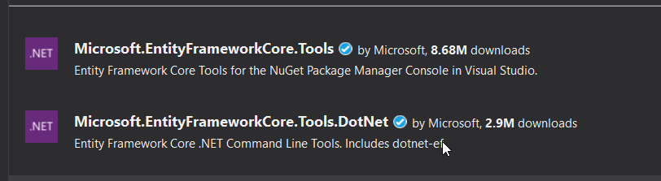
EF Core Tooling: CLI / VS Code
Same tools 2 interfaces
Notes:
Some articles on performance tuning:
https://www.thereformedprogrammer.net/entity-framework-core-performance-tuning-a-worked-example/

Slide 17
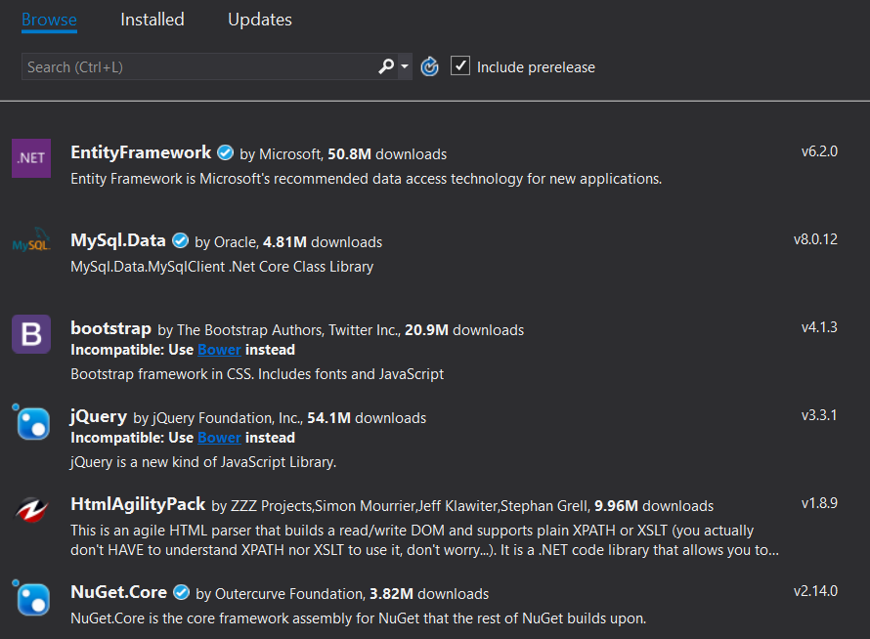
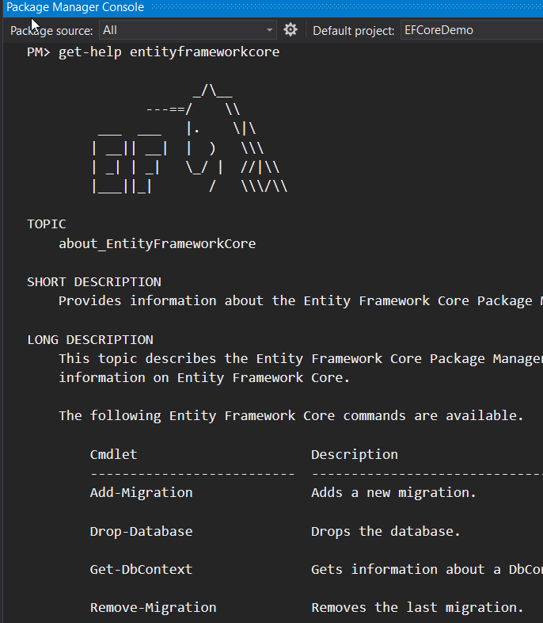
EF Core Tooling: Visual Studio
EF Core Package
Database Provider
Tools
Design Package
Notes:
Some articles on performance tuning:
https://www.thereformedprogrammer.net/entity-framework-core-performance-tuning-a-worked-example/

Slide 18
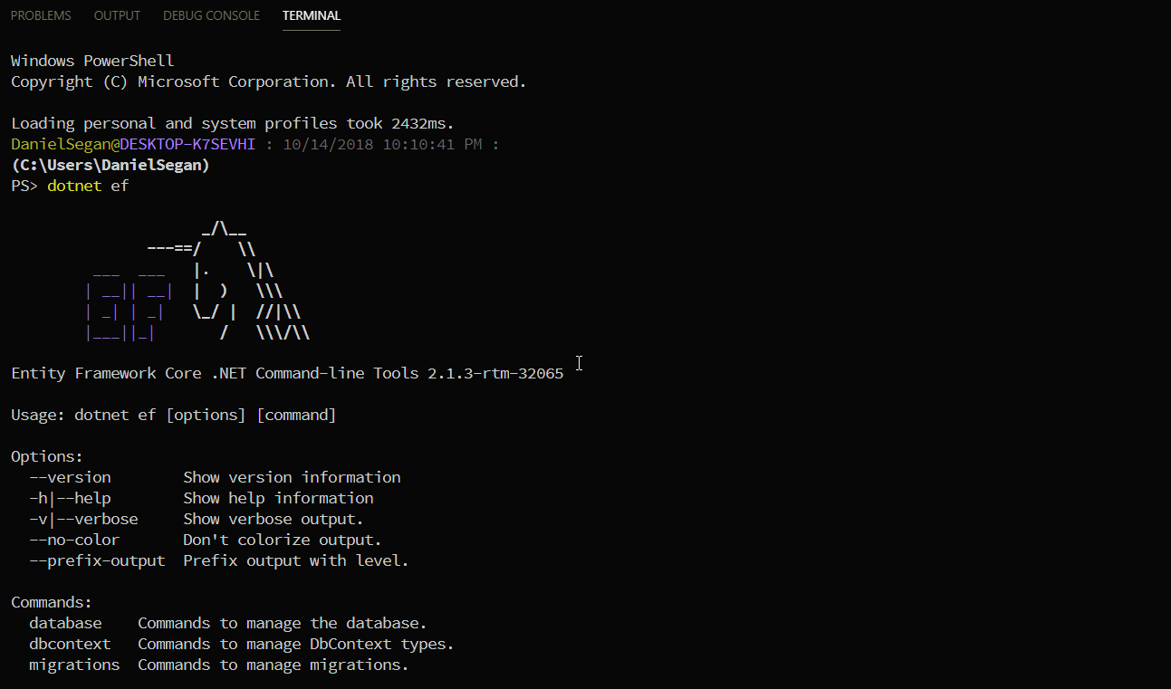
EF Core Tooling: VS Code
Notes:
Some articles on performance tuning:
https://www.thereformedprogrammer.net/entity-framework-core-performance-tuning-a-worked-example/

Slide 19
Demo 1: Tooling
Visual Studio 2017
VS Code & CLI

Slide 20
EF Core Tooling: Visual Studio
Notes:
Some articles on performance tuning:
https://www.thereformedprogrammer.net/entity-framework-core-performance-tuning-a-worked-example/

Slide 21
Demo 2: Basics
Domain/Data Model

Slide 22
EF Core Tooling: CLI / VS Code
Notes:
Some articles on performance tuning:
https://www.thereformedprogrammer.net/entity-framework-core-performance-tuning-a-worked-example/

Slide 23
EF Core Tooling: CLI / VS Code
Notes:
Some articles on performance tuning:
https://www.thereformedprogrammer.net/entity-framework-core-performance-tuning-a-worked-example/

Slide 24
EF Core Tooling: CLI / VS Code
Notes:
Some articles on performance tuning:
https://www.thereformedprogrammer.net/entity-framework-core-performance-tuning-a-worked-example/

Slide 25
Demo 3: Migrations
Visual Studio 2017
VS Code & CLI

Slide 26
EF Core Tooling: CLI / VS Code
Notes:
Some articles on performance tuning:
https://www.thereformedprogrammer.net/entity-framework-core-performance-tuning-a-worked-example/

Slide 27
EF Core Tooling: CLI / VS Code
Notes:
Some articles on performance tuning:
https://www.thereformedprogrammer.net/entity-framework-core-performance-tuning-a-worked-example/

Slide 28
EF Core Tooling: CLI / VS Code
Notes:
Some articles on performance tuning:
https://www.thereformedprogrammer.net/entity-framework-core-performance-tuning-a-worked-example/

Slide 29
Demo 4: Complex Relationships
Visual Studio 2017
VS Code & CLI

Slide 30
Resources
Julie Lerman
Pluralsight Courses, Talks, Twitter etc.
MSDN Magazine
.NET Blog
Entity Framework Tag
GitHub
aspnet/EntityFrameworkCore
EF Core Power Tools
ErikEJ/EFCorePowerTools
EF Core Roadmap
Notes:
Julie is one of the leading experts on EF. If you have looked into EF at all, you probably know her name. Her pluralsight courses are great and her content is my go-to for any training or deep info. She’s also big on domain driven design.
The .NET Blog has EF specific tags.
Project Site on GitHub
PowerTools

